Slide 1
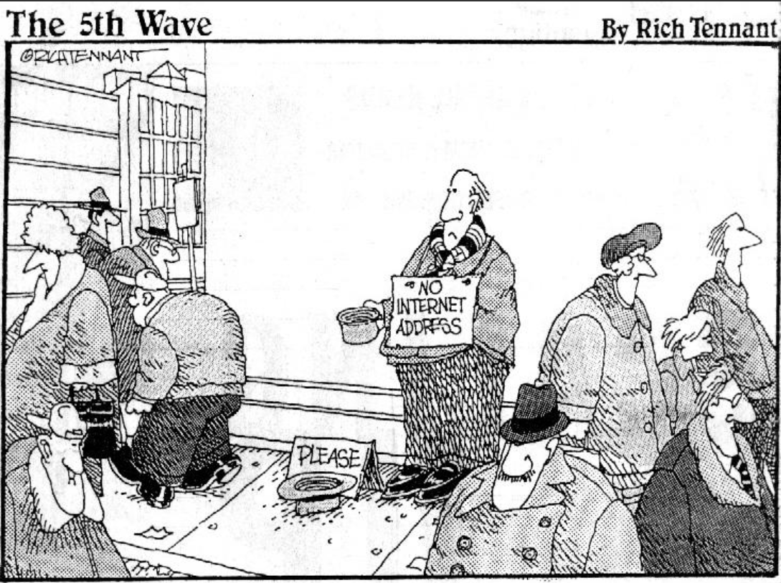

IPv6 Overview
Why, When, Where, What, and How of IPv6
James Small, Sr. Consultant and Chief IPv6 Evangelist at CDW

Slide 2
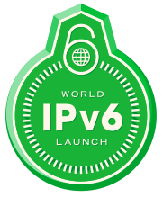
Overview Objectives
Why IPv6
IPv6 Current Landscape
IPv6 Technical Overview
IPv6 Pilot Plan
Q&A throughout, I may postpone questions until the end depending on time

Slide 3
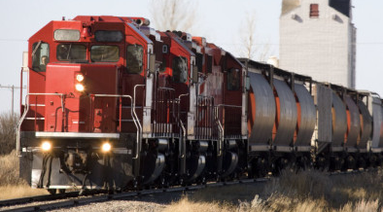
Why IPv6
Address space
Should be a virtually unlimited supply – think street addresses
Facilitates communication/collaboration
Innovation
NAT Gateways make innovation harder (mainly driven by insufficient address space)
Productivity (easy communication/collaboration) is a key business objective which NAT impedes
Notes:
So simple and yet – this is the most important part of the entire presentation!
IPv6 was standardized in 1998. Back then though, NAT was a “good enough” solution and there was little interest in deploying IPv6. Fast forward to today where mobile devices alone will exceed the planet’s population before the end of the year! There are currently more than 11 billion unique nodes connected to the Internet using an addressing system designed for only 4 billion nodes. Even with NAT, the current IPv4 addressing system is buckling and exhaustion of the current addressing system is fast approaching.
So why does an addressing system matter?
Address space:
I’m a builder. I’m building a new subdivision and need to get addresses for the streets and homes.
Do I worry about running out of addresses?
Do I worry about conserving address space or optimizing the number of addresses available per street or in the neighborhood?
Do I try to hide the entire neighborhood behind one public address to conserve address space or improve security?
It’s hard to see the trap we’ve fallen into with IPv4 without stepping outside the network realm and looking at similar situations elsewhere.
Why do we need addresses? They facilitate communication/collaboration
IPv4 has insufficient address space – like the area code problem
Just like with area codes, putting people behind PBXes is not a great solution
Given a choice, everyone would prefer to have a DID or their own number
Putting people behind 2 PBXes (CGN) is even worse
IPv4 has resulted in scarcity type thinking
The formation of IPv4 markets for trading/transferring/selling addresses is further proof that IPv4 needs to be replaced
Additional addressing pressures
Per the Cisco Visual Network Index
2016 - 19 billion network connections, 3.4 billion users connected to Internet
2020 - Over 50 billion devices connected to Internet
This in a system only designed to deal with 4 billion unique nodes
Innovation
NAT Gateways make innovation harder (main driven by insufficient address space)
Productivity (easy communication/collaboration) is a key business objective which NAT impedes
IPv6 provides the option of end to end communication promoting and simplifying communication and collaboration

Slide 4

Roadmap
Why IPv6
IPv6 Current Landscape
IPv6 Technical Overview
IPv6 Pilot Plan
Notes:
Should be here at around 5 minutes

Slide 5
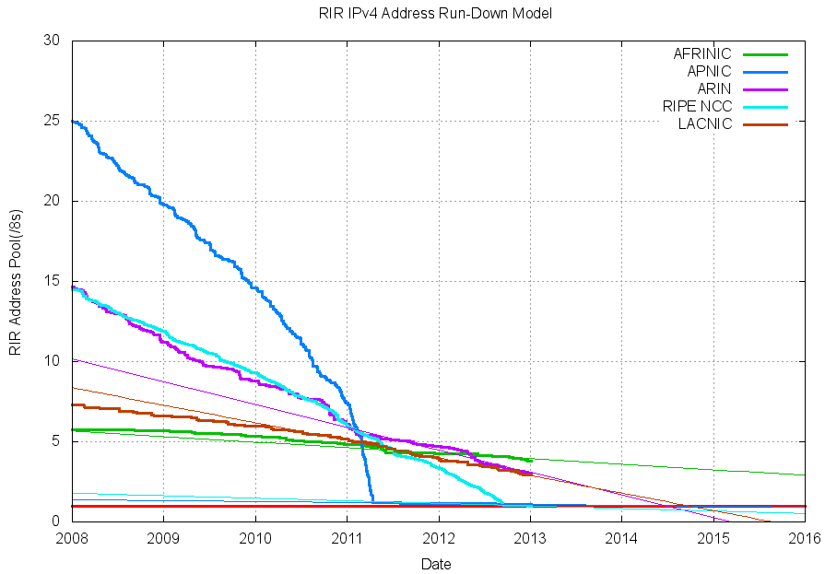
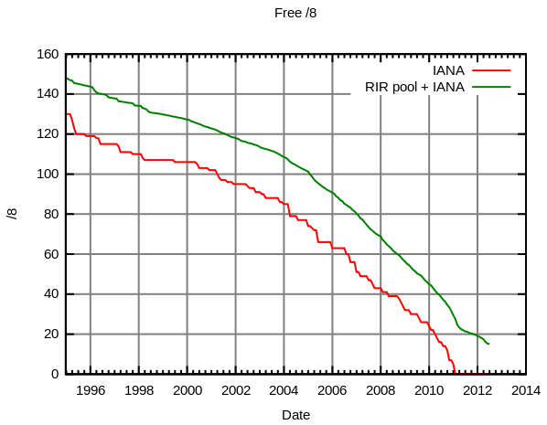
Drivers
IPv4 Address Depletion
IANA Free Pool Depleted – February, 2011
APNIC Depletion – April, 2011
RIPE Depletion – September, 2012
ARIN Depletion – Predicted for June, 2014
Price for public IPv4 addresses going up
Depletion Facts
As of January 2013, there are < 113 million IPv4 addresses remaining before all global registries enter depletion mode
Last year, 114 million addresses were allocated (down from a peak of 249 million in 2010)
For this year (2013), based on 2012 allocations another 76 million addresses will be used
Notes:
Key fact of depletion – once an RIR is depleted, you can’t get PI space any more!

Slide 6
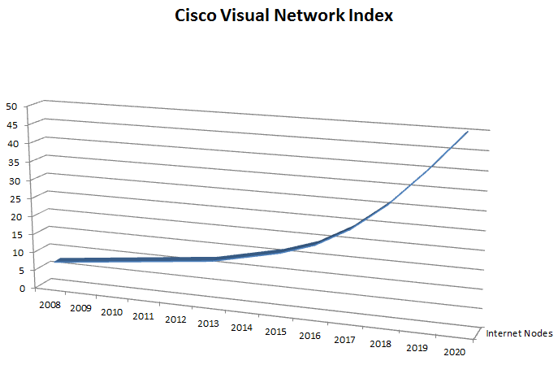
Drivers
Geometric Growth of Internet Connected Devices
2015 – 15 billion unique nodes
2016 – 19 billion unique nodes
2020 – 50 billion unique nodes
World Internet Users – 2.5 billion out of 7 billion (36%)
This will double in 5 years
The number of connected mobile devices is now greater than the world’s population
By 2016 there will be over 10 billion
Over 10 billion new micro- controllers are shipped each year with more and more networked - The Internet of Things

Slide 7

Drivers
Explosion of mobile devices connected to the Internet
2015 – Average American will have 10 networked devices
Laptop Tablet
Smartphone Umbrella with weather forecasting
Smart Pill Dispensers Cars connected to ITS
Exercise Monitors Glasses with Internet Video
Clothing sensors Wearable computing
US Federal Government Deployment
39% deployed (Internet facing)
Internal deployment by September, 2014
VA & DOD – IPv6 only by 2015

Slide 8
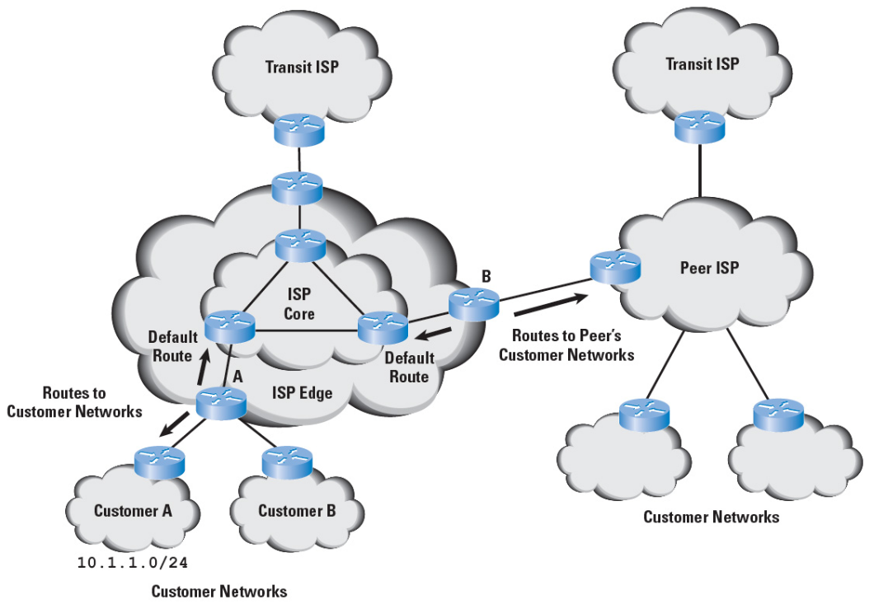
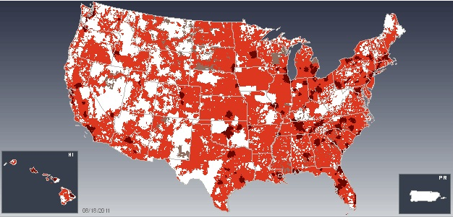
Drivers
ISP Deployment
Comcast
2.5% of traffic now IPv6
US Residential Deployment to be complete in June, 2013
Time Warner
CGN costs $40/user per year
CGN will drive up costs for IPv4 Internet access (13-21%)
Time Warner, AT&T, Verizon Wireless all exceeded 1% of traffic using IPv6 in June (2012)
LTE/4G Deployment
IPv6 preferred protocol
Verizon LTE using IPv6 now
T-Mobile new Windows 8 4G phones using IPv6 now
AT&T, Sprint 4G/LTE IPv6 coming soon

Slide 9
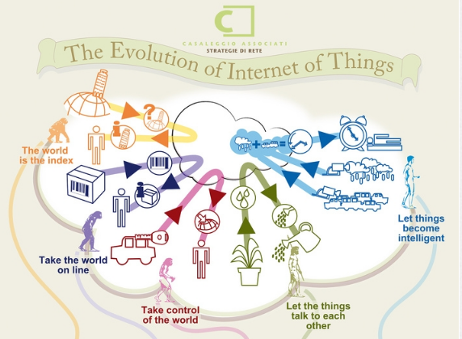
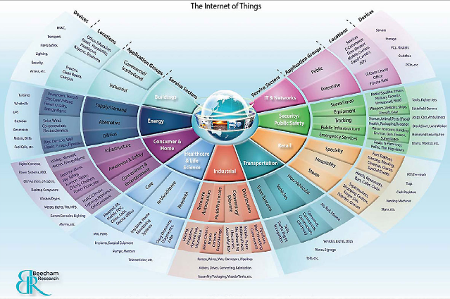

Drivers
Internet of Things
Smart Grid (Meters) largely IPv6 – Consumers Energy in Michigan)
6LoWPAN (802.15.4) – New Wireless Light Bulbs, Sensors, Building Automation
Intelligent Transportation System – US DOT
Health Monitoring
Machine to Machine communication for any electronic device
Gartner – Top 10 Strategic Technologies for 2012 and 2013

Slide 10
Major Internet sites have ipv6 addresses
86% of Top Level Domain Names support IPv6
41% of Globally Registered Domains have IPv6 Addresses
Since World IPv6 Launch in June, many major Internet sites now advertise IPv6 Addresses in DNS:
C:\>nslookup www.google.com C:\>nslookup www.facebook.com
(…) (…)
Name: www.l.google.com Name: www.facebook.com
Addresses: Addresses:
2607:f8b0:4002:802::1010 2a03:2880:10:1f03:face:b00c:0:25
173.194.73.106 69.171.237.32
(…)
Aliases: www.google.com

Slide 11
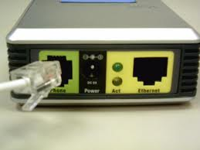
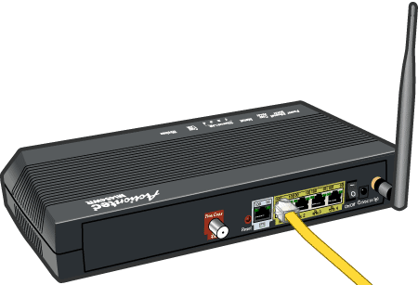

IPv6 support for ISPs
Residential ISPs, Largest First
Cable (1 Million+ Subscribers) | xDSL (1 Million+ Subscribers)
Comcast – Deploying since 2011 | AT&T – Deploying since 2011
Time Warner – Deploying | Verizon – Deploying
Cox – Residential trials this year | CenturyLink (Qwest/Savvis) – Deploying
Charter – Deploying | Frontier - ? (Yes for Business)
Cablevision - Testing | Windstream - ? (Yes for Business)
Tier 1 ISPs – Fully Deployed
AT&T | Verizon Business (UUNET)
Level 3 | CenturyLink (Qwest/Savvis)
Sprint | XO Communications
Top 20 ISPs | Inteliquent (Tenet)

Slide 12



Content Providers with IPv6
Akamai – Delivers 15-30% of all web traffic
Of Top 10 US Sites, 5 have IPv6 enabled:
1) Google 2) Facebook
3) YouTube 4) Yahoo
6) Wikipedia
Netflix – Up to 32.7% of Internet bandwidth
22% of top Alexa 500 sites including
Bing, AOL, XBOX, WebEx,
US News, USDA, NYU, …
Notes:
Note that Wikipedia being shown as 6 is not a mistake, Wikipedia is the 6th most popular web site, #5 is not currently supporting IPv6

Slide 13


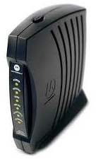

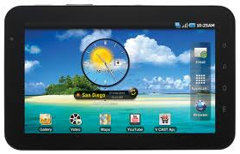


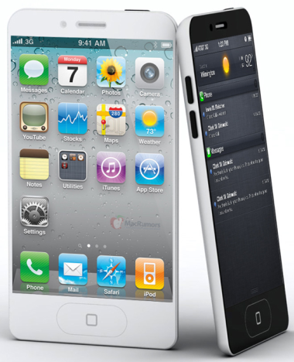
Consumer IPv6 State
All current Operating Systems have IPv6 on by default
ISP Customer Premise Equipment now supports IPv6 and is on by default
Where AT&T and Comcast enable IPv6 up to 40% of user traffic switches to IPv6
All LTE/4G devices will use IPv6 with mobile devices outnumbering PCs this year
Notes:
XP and 2003 do not have IPv6 enabled by default, it must be turned on
Many native Operating System applications and some functionality does not support IPv6 for XP/2003
IPv6 CPE support has been a problem in the past, but this year there has been much attention focused here with steadily improving results
Note – Windows XP represents about 42% of Internet web traffic and is steadily declining with Microsoft terminating all support in April of 2014 Windows 7 will become the dominant O/S for web traffic this month followed by XP, Vista, and Apple OS X:
Testing home routers for World IPv6 Launch: http://www.networkworld.com/news/tech/2012/082912-home-routers-ipv6-262043.html
UNH IOL IPv6 Certified CPE/CE Routers: https://www.iol.unh.edu/services/testing/hnc/cerouter.php

Slide 14
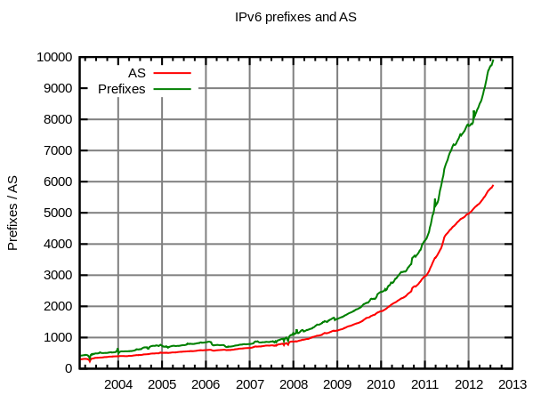
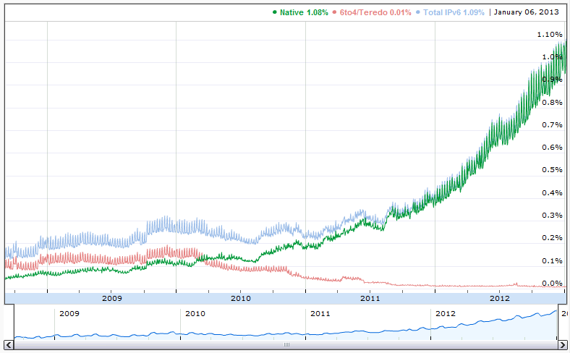
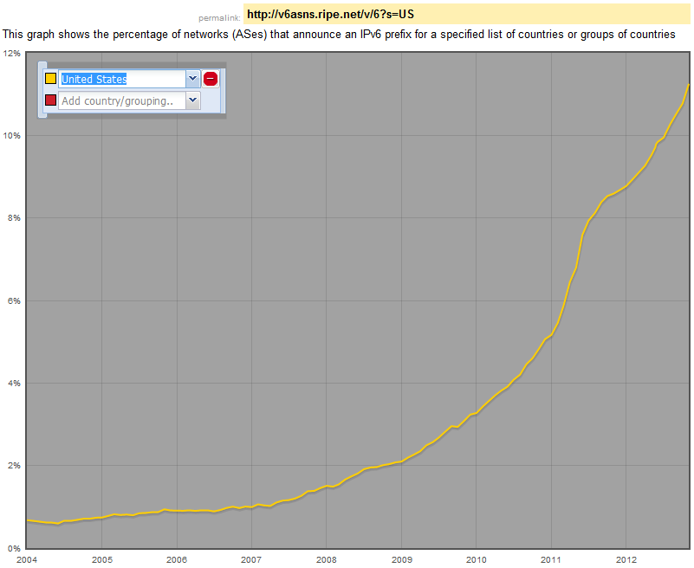
Watching IPv6 Internet Growth
Growth of IPv6 Networks
Ramp up of IPv6 traffic globally at Google (150% increase/year)
Exponential growth since 2010
% US Administrative Network Domains with IPv6

Slide 15
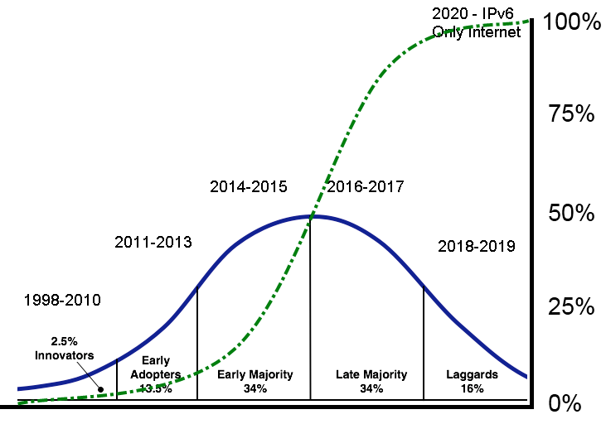
Enterprise IPv6 Adoption
Percentage of Internet Traffic which is IPv6
US IPv6 Adoption Lifecycle
Notes:
Note: This is Enterprise focused, Service Providers are either in or transitioning to the Late Majority phase
Innovators – (1998 – 2010)
these are the visionaries, they chart the future
Early Adopters – (2011-2013)
the big event in 2011 was the depletion of the IANA free pool of IPv4 addresses in February, this was the first ripple in the IPv4 Internet
later that year (2011) APNIC also entered depletion mode causing much pain in Asia, especially China and India
large companies with an Asian presence are either deploying or looking hard at IPv6
the big event for this year (2012) will be the depletion of RIPE which covers Europe, this will hit well before the year’s out
multi-nationals with a European foot print will feel increasing pressure to deploy or begin planning their IPv6 roll out
the big event for next year (2013) will be the depletion of our own ARIN
the depletion of ARIN will send shockwaves throughout the Internet, this will be the big sign that IPv4’s days are now numbered
Early Majority – (2014-2015)
Most US residential ISPs will have completed their deployments by 2014 (there is good data to support this from Time Warner Cable studies, preso at RMTF IPv6 Summit)
the general deployment of IPv6 in the Enterprise space will begin in earnest
IPv6 traffic will now be prominent on the Internet perhaps even approaching 50% by the close of the year (2014) {data to support this, from AT&T where IPv6 is deployed end to end today over 40% of traffic shifts to IPv6}
Late Majority – (2016-2017)
With the majority of the Internet now using or implementing IPv6 those that have been feet dragging will be now be deploying
Laggards – (2018-2019)
Those that have managed to make it this far without deploying IPv6 will be deploying
IPv6 Only Internet – (2020)
From a conservative estimate by AT&T, IPv4 will be gone from the Internet by 2020, perhaps even sooner
http://www.theinquirer.net/inquirer/news/2100923/-plans-networks-ipv6-2020

Slide 16
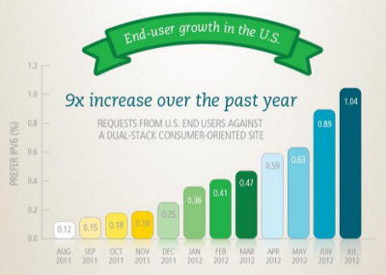
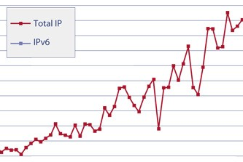
American IPv6 growth
US IPv6 capable users: 2.18%
Over 57% of US transit AS support IPv6
Over 29% of US viewed Internet content is available via IPv6
US will hit critical mass for IPv6 (10%) in 2014
At current growth rate, 50% of global traffic will be IPv6 by 2017
Gartner
Between now (2012) and 2015 organizations should be connected to IPv6 Internet
By 2015 17% of Internet will use IPv6
By 2015 28% of new Internet users will be running IPv6
(Above stats are global, will be much higher in US)
Typical timeline for Enterprise IPv6 Deployment: 3 – 5 years
IPv6 is real – don’t get left behind

Slide 17

Roadmap
Why IPv6
IPv6 Current Landscape
IPv6 Technical Overview
IPv6 Pilot Plan
Notes:
Should be here around 35 minutes

Slide 18
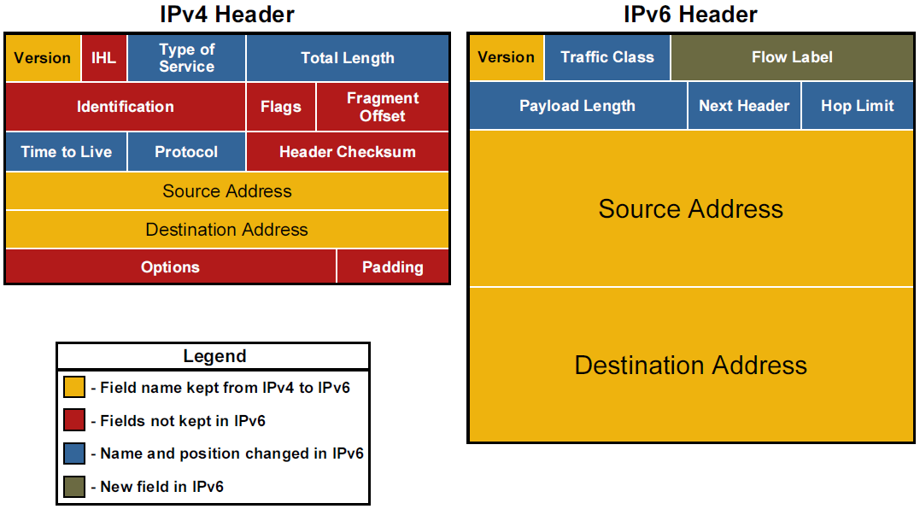
ipv4 and ipv6 header comparison

Slide 19
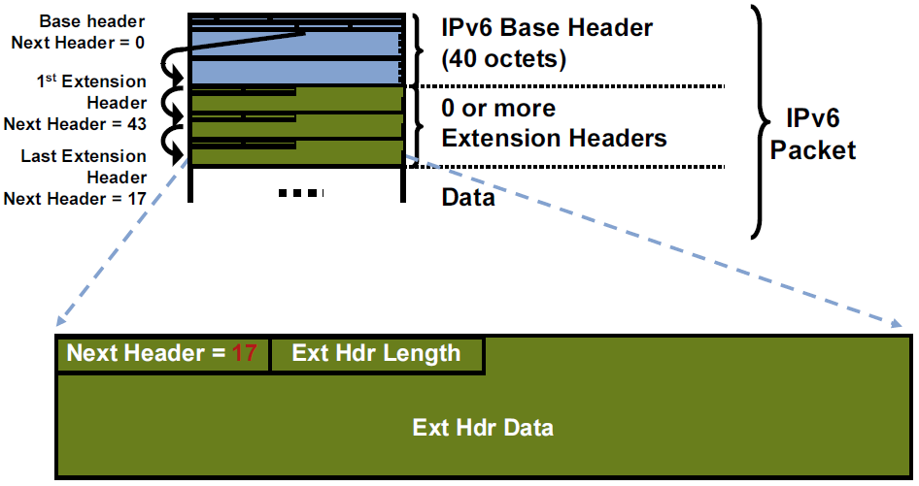
ipv6 extension headers

Slide 20
Extension headers and their order
Type | Number
Hop-by-Hop | 0
Destination Options (w/ routing header) | 60
Routing | 43
Fragment | 44
Authentication (IPsec) | 51
ESP (IPsec) | 50
Mobility | 135
Destination Options | 60
ICMPv6 | 58
No Next Header | 59
(Upper Layer) | e.g. TCP=6, UDP=17

Slide 21
IPv6 Changes from IPv4
Broadcasts
Fragmentation only done by end nodes, not by routers
ARP replaced by NDP, a subset of ICMPv6
IGMP replaced by MLD, a subset of ICMPv6
DHCP replaced by RAs (subset of NDP) + DHCPv6
Nodes can auto-configure address with SLAAC (use RAs)
NetBIOS/WINS do not function with IPv6
UNC paths based on address must use ipv6-literal.net space
\\2001-db8-28-3-f8a-5b31-67b7-6ef.ipv6-literal.net\docs
Blocking ICMPv6 will completely break IPv6!!!
Careful with firewall/route/switch/operating system ACLs
Minimum MTU changes from 68 to 1280

Slide 22
what’s new with IPv6 addressing?
Size
Address is 4x as big – essentially limitless address space
Scalable Multicast
Assigned IPv6 prefix provides globally unique range
Internet multicast services now possible
Rendezvous Point can be embedded in address
Scoping
Link-local – only meaningful per link
ULA – non-Internet-routable, scalable, non-overlapping space
Multicast scopes from host local to Internet global

Slide 23
what’s new with IPv6 addressing?
Multiple Addresses per Interface
All IPv6 enabled interfaces will now have at least 2 addresses, more not unusual
Addresses will include link-local and either ULA or GUA
Address lifetimes make hot migrations possible
Plug-in-play
Like IPX and DECNet, IPv6 provides automatic addressing
When you configure a router on a link/subnet, all IPv6 capable hosts will automatically configure themselves and start using (and preferring) IPv6
Possibilities
No real "usable" security or other benefits yet, but…
Many great ideas for security and flow management – expect to see innovation here

Slide 24
IPv4 versus ipv6 addressing
Type | IPv4 | IPv6
Unspecified | 0.0.0.0 | ::
Loopback | 127.0.0.1 | ::1
“Link-Local” | 169.254.251.1 | fe80::584c:7cf5:4a0e:3ce9%17
“Private” | 10.152.16.87 | fd8d:8b76:0494:659b::4ae:3ce9
Public | 12.203.95.104 | 2001:46e:cae8::a7:1afe:e91d
Multicast | 224.0.0.18 | ff02::1:ff94:e774
“Broadcast” | 255.255.255.255 | ff02::1

Slide 25
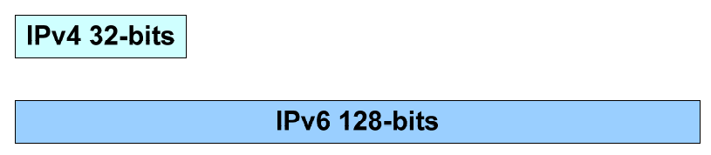
IPv6 Address magnitude
2³² = 4,294,967,296
2¹²⁸ = 340,282,366,920,938,463,463,374,607,431,768,211,456
2¹²⁸ = 2³² * 2⁹⁶
2⁹⁶ = 79,228,162,514,264,337,593,543,950,336
times the number of possible IPv4 addresses
(79 trillion trillion)

Slide 26
ipv6 address structure
Hexadecimal digits (0-9, a-f)
8 groups of 16 bit (4 digit) numbers
Groups separated by colons (:)
Digits not case sensitive, but lower case preferred
Abbreviations are possible
Can omit leading zeroes
Can substitute longest string of zeroes with double colon (::)
Examples:
2001:db8:cafe:f0a2:a8b0:2:ffe1:a90b
fd92:e075:819c:7a2::fc9a:105
fe80::f413:9b1e:9f3:feb6
ff05::fb

Slide 27
ipv6 addressing basics
IPv6 prefixes/addresses always use CIDR notation:
IPv4 – 192.0.2.0/24
IPv6 – 2001:db8:101::/48
IPv6 addresses can omit leading zeroes, but not trailing ones:
2001:0db8:0101:00a0:0000:0000:0d20:9ce5
Becomes:
2001:db8:101:a0:0:0:d20:9ce5
But Not (Just like 010 = 10, but 010 ≠ 1, 010 ≠ 01)
2001:db8:101:a:0:0:d2:9ce5
2001:db8:101:00a:0:0:0d2:9ce5
IPv6 addresses can substitute longest string of zeroes with a double colon:
2001:db8:101:a0::d20:9ce5

Slide 28
ipv6 address scope, lifetime, and types
Link Local – fe80::/10 (link only significance)
Unique Local – f700::/7 (not routable on Internet)
Global – 2000::/3 (currently IANA allocated address space)
Address Lifetimes
Valid – How long address can be used for connections
Preferred – How long address can be used to initiate connections
Address Types
Unicast – As in IPv4
Broadcast Multicast – From IPC to Global Communication
Anycast – Same service on multiple devices with closest one selected

Slide 29
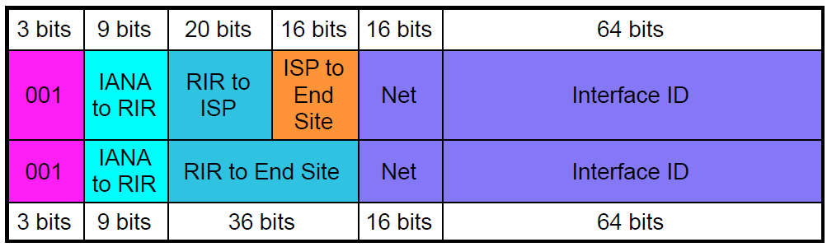
ipv6 Global address bit hierarchy
Global unicast addresses being allocated from 2000::/3
Top – Provider Assigned (PA) address space
Bottom – Provider Independent (PI) address space
End sites get a /48 (65k networks)
From Owen DeLong@he.net’s Intro to IPv6 presentation pg. 21

Slide 30
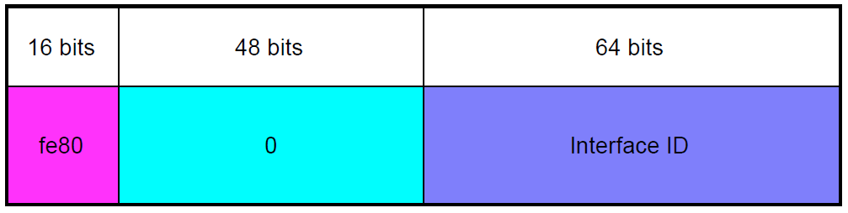
ipv6 Link Local address bit hierarchy
Always fe80::/64 on every link
Never forwarded/routed to another network (link scope)
Must be present for interface to participate in IPv6, auto-configured
ZoneID used to uniquely identity links:
UNIX: ping6 fe80::101:1%eth0 (ifconfig -a)
Windows: ping fe80::101:1%12 (ipconfig/all)
From Owen DeLong@he.net’s Intro to IPv6 presentation pg. 22

Slide 31
ipv6 Address space
Address Range | Description
0000-00FF::/8 | Reserved and Special Purpose
0100-1FFF::/4 | Reserved
2000-3FFF::/3 | Global Unicast Addresses
2000-2CFF | Allocated
2D00-3FFF | Unallocated
4000-FBFF | Reserved (5 more /3s, a /4, /5, & /6)
FC00-FDFF::/7 | Unique Local Unicast Addresses
FC00-FCFF::/8 | Reserved for centralized allocations
FD00-FDFF::/8 | Unrestricted – no registry/registration
FE00-FE7F::/9 | Reserved
FE80-FEBF::/10 | Link-local Addresses
FEC0-FEFF::/10 | Reserved (Formerly Site-Local)
FF00-FFFF::/8 | Multicast

Slide 32
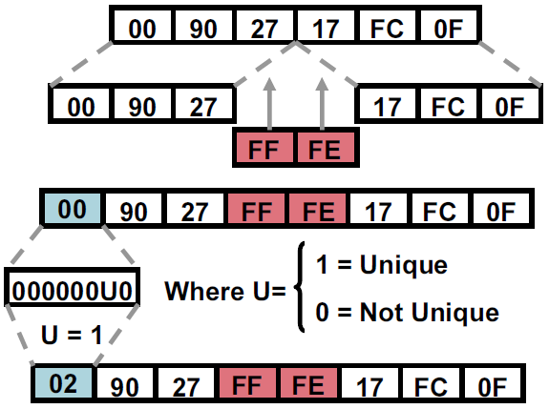
ipv6 interface addressing
Always 64 bits – Why?
IEEE hands out 48 bit (EUI-48) and 64 bit (EUI-64) MACs
Original idea was to use MAC to generate IID like in IPX
For 48 bit MACs, you insert 0xFFFE in the middle to generate a 64 bit address (IEEE Rule)
The “U” bit is also flipped (Modified EUI-64) This is so if you create a local address you can use 2001:db8::1 instead of 2001:db8::0200:0:0:1 Wasn’t that nice of them?

Slide 33
ipv6 interface addressing
Modified EUI-64 was originally used for Stateless Auto Address Configuration (SLAAC)
When a node received an RA it used the prefix(es) and M-EUI-64 to create addresses
Unfortunately M-EUI-64 based addresses can be used as a super cookie
To address this, privacy extensions were created (RFC 4941)
With privacy extensions, the IID is essentially a random number that can periodically change
Privacy addresses are great for consumers but problematic for the enterprise
DHCPv6 relays don’t include client MAC address
Privacy addresses make accountability/security difficult because addresses periodically rotate/change

Slide 34
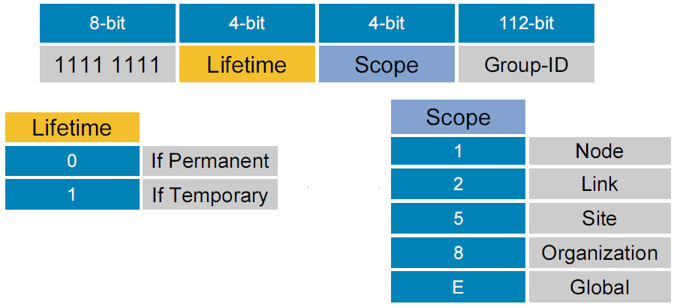
ipv6 Multicast addressing
FF00::/12 – Well known (e.g. OSPFv3)
FF10::/12 – Locally defined
FF30::/12 – Locally defined using global unicast prefix
FF70::/12 – Locally defined using prefix with embedded RP
Bits:
1111-1111-0RPT-SSSS-0000-IIII-LLLL-LLLL-<64 bit prefix>-<32 bit GID>
R=Embedded RP
P=Global Prefix
T=Locally Defined
S=Scope Bits
I=RP Address
L=Prefix Length

Slide 35
IPv6 special addresses
IPv4 Compatible - ::<IPv4> (deprecated)
IPv4 Mapped - ::FFFF:<IPv4>
Discard Prefix - 0100::/64 (Implement RTBH)
Well Known Prefix - 64:ff9b::/96 (NAT64)
Teredo - 2001:0000::/32 (Tunnel through NAT)
Documentation - 2001:db8::/32
6to4 - 2002::/16 - 6to4 (Tunnel through IPv4)
2002:<Public IPv4 Address>::/48 (Private IPv4 Address undefined)
ISATAP (IntraSite Tunnel through IPv4)
64 bit Unicast Prefix:0:5efe:<Private IPv4 Address>
64 bit Unicast Prefix:200:5efe:<Public IPv4 Address>
Solicited-Node Multicast
ff02::1::ff00:0/104 + last 24 bits of IPv6 Address

Slide 36
multi-protocol realities
IPv4 L2 Cache:
# arp -a
athena.int.level14.net (192.168.234.142) at 00:0c:29:e9:bc:50 [ether] on eth0
honeydrop.local (192.168.234.180) at 00:26:2d:fc:05:9b [ether] on eth0
hsrp-vl101.int.level14.net (192.168.234.129) at 00:00:0c:9f:f0:65 [ether] on eth0
IPv6 L2 Cache:
root@ubuntu12:~# ip -6 neigh show
fe80::101:2 dev eth0 lladdr a8:b1:d4:60:11:41 router STALE
2001:470:c4e9:fb1:3fd:6182:d9b6:b027 dev eth0 lladdr 00:26:2d:fc:05:9b REACHABLE
fe80::101:1 dev eth0 lladdr 00:05:73:a0:00:66 router STALE
fe80::19:7ff:fe24:4fcb dev eth0 lladdr 02:19:07:24:4f:cb router STALE
2001:470:c4e9:fb1::101:a861 dev eth0 lladdr 00:0c:29:80:a8:61 STALE

Slide 37
multi-protocol realities
IPv4 Firewall
# iptables -nL
Chain INPUT (policy ACCEPT)
target prot opt source destination
ACCEPT icmp -- 0.0.0.0/0 0.0.0.0/0
ACCEPT all -- 0.0.0.0/0 0.0.0.0/0 state RELATED,ESTABLISHED
ACCEPT tcp -- 0.0.0.0/0 0.0.0.0/0 tcp dpt:22
IPv6 Firewall
root@ubuntu12:~# ip6tables -nL
Chain INPUT (policy ACCEPT)
target prot opt source destination
ACCEPT icmpv6 ::/0 ::/0
ACCEPT all ::/0 ::/0 state RELATED,ESTABLISHED
ACCEPT tcp ::/0 ::/0 tcp dpt:80
IPv4 and IPv6 are ships in the night!

Slide 38
Ipv6 and DNS
DNS has supported IPv6 for a long time – only a new resource record for the address and alternate pointer name space:
IPv4 – A Record:
arin.net. IN A 192.149.252.75
IPv6 – AAAA Record:
arin.net. IN AAAA 2001:500:4:13::80
IPv4 – PTR Record:
75.252.149.192.in-addr.arpa. IN PTR www.arin.net.
IPv6 – PTR Record:
0.8.0.0.0.0.0.0.0.0.0.0.0.0.0.0.3.1.0.0.4.0.0.0.0.0.5.0.1.0.0.2.ip6.arpa. IN PTR www.arin.net.
Transport agnostic - works equally well over IPv4 or IPv6, careful!

Slide 39
Linux IPv6 Tools
General:
ping → ping6
traceroute → traceroute6
tracepath → tracepath6
More:
host/nslookup/dig – same tool, may have to specify IPv6 records (e.g. AAAA)
telnet (still useful for raw connection to service) - same
ssh - same
Network Analysis:
tcpdump – only filtering options change
wireshark – only filtering options change

Slide 40
linux ipv6 tool quirks
IPv6 literals (RFC 3986)
Generally means enclose the IPv6 address in brackets:
2001:db8:fb::1a → [2001:db8:fb::1a]
Necessary or many programs will interpret colons as port number delimeter
Much more “interesting” if you use link local or multicast as you must specify the interface with a zone identifier
Examples:
wget http://[2001:500:4:13::80] – works fine
curl http://[2001:500:4:13::80] – doesn’t work:
curl: (3) [globbing] error: bad range specification after pos 9
Known issue, must use “-g”:
curl -g http://[2001:500:4:13::80]

Slide 41
Linux Ipv6 Guidance
Start with the Linux IPv6 How To:
http://www.tldp.org/HOWTO/Linux+IPv6-HOWTO/index.html
Many things depend on the distro – check out wikis/documentation:
Ubuntu: https://wiki.ubuntu.com/IPv6
Debian: http://madduck.net/docs/ipv6/

Slide 42

monitoring and controlling ipv6
Service | Number | Description
IPv6 Encapsulation | IPv4/41 | Tunnel IPv6 over IPv4
Generic Tunnel | IPv4/47 | Tunnel anything over GRE
Teredo/Miredo | UDP/3544 | Tunnel IPv6 over UDP (NAT Traversal)
Teredo/Miredo | Non-Standard | IPv6 destination starting with 2001:0000::/32 over UDP over IPv4
TSP | TCP|UDP/3653 | IPv6 Tunnel Broker using the Tunnel Setup Protocol (RFC 5572)
AYIYA | TCP|UDP/5072 | IPv6 Tunnel Broker using Anything in Anything (www.sixxs.net/tools/ayiya/)
Public 6to4 Anycast Relay | IPv4:192.88.99.1 | Starting with IPv6 source address of 2002::/16 (6to4 is IPv6 over IPv4/41) Destined to 192.88.99.0/24 for IPv4
IPv6 Encapsulation | TCP/443 | IPv6 over IPv4 SSL Tunnel, many variants
IPv6 Ethertype | 0x86DD | Distinct from IPv4 Ethertype (0x0800)
DNS IPv6 Records | Several | AAAA, updated PTR records - can be transported over IPv4 or IPv6
Image source: gfi.com
Notes:
Once you start getting familiar with IPv6, watch for the following

Slide 43
ipv6 Security
Common IPv6 L2 Security Issues and Options:
Issue | Solution
Spoofed/Illegitimate RAs | RA Guard (or PACL)
Spoofed NDP NA | MLD Snooping, DHCPv6 Snooping, NDP Inspection, SeND
(Spoofed) Local NDP NS Flood | NDP Inspection, NDP Cache Limits, CoPP
(Spoofed) Remote NDP NS Flood | Ingress ACL, CoPP, NDP Cache Limits
(Spoofed) DAD Attack | MLD Snooping, NDP Inspection
(Spoofed) DHCPv6 Attack | DHCPv6 Guard
Spoofed/Illegitimate DHCPv6 Replies | DHCPv6 Guard
Notes:
SeND is interesting but no support (or plans) from Microsoft or Apple so of questionable value

Slide 44
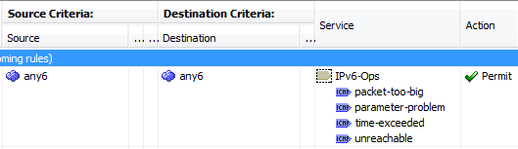
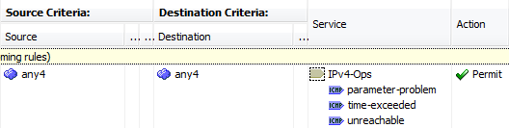
ipv6 access control
Firewall Policy
Don’t block all ICMPv6!!!
Simple Examples for transit traffic, can get more granular:
Reference NIST SP 800-119 (Section 3.5, Table 3-7)
Reference RFC 4890 (Recommendations for Filtering ICMPv6 Messages in Firewalls)

Slide 45
Roadmap
Why IPv6
IPv6 Current Landscape
IPv6 Technical Overview
IPv6 Pilot Plan
Notes:
Should be here around 35 minutes

Slide 46
pilot plan – initial software
Key Services
Dual Stack DNS Server with DNS64 support
Dual Stack DHCP/DHCPv6 Server
Dual Stack File Server
Dual Stack Web Server
Key Applications (e.g. E-mail, Directory Services, User/Web Apps)
Bonus Items:
IPAM Solution
Notes:
Key Services – Don’t forget your key applications too!
Dual Stack DNS Server
Windows Server 2008 R2 or 2012
BIND 9.8 or 9.9 (need at least 9.8 for DNS64) – 2012 may also be an option for DNS64 but not clear if this is just for DirectAccess or generalized solution
Dual Stack DHCP/DHCPv6 Server
Windows Server 2008 R2 or 2012
Dual Stack File Server
Windows Server 2008 R2 or 2012
Linux Server (e.g. Ubuntu 12.04+) running Samba
Dual Stack Web Server
IIS on Windows Server 2008 R2 or 2012
Apache on Linux Server (e.g. Ubuntu 12.04+)
Bonus Items:
DDI (IPAM) Solution (e.g. Infoblox or BlueCat Networks)

Slide 47
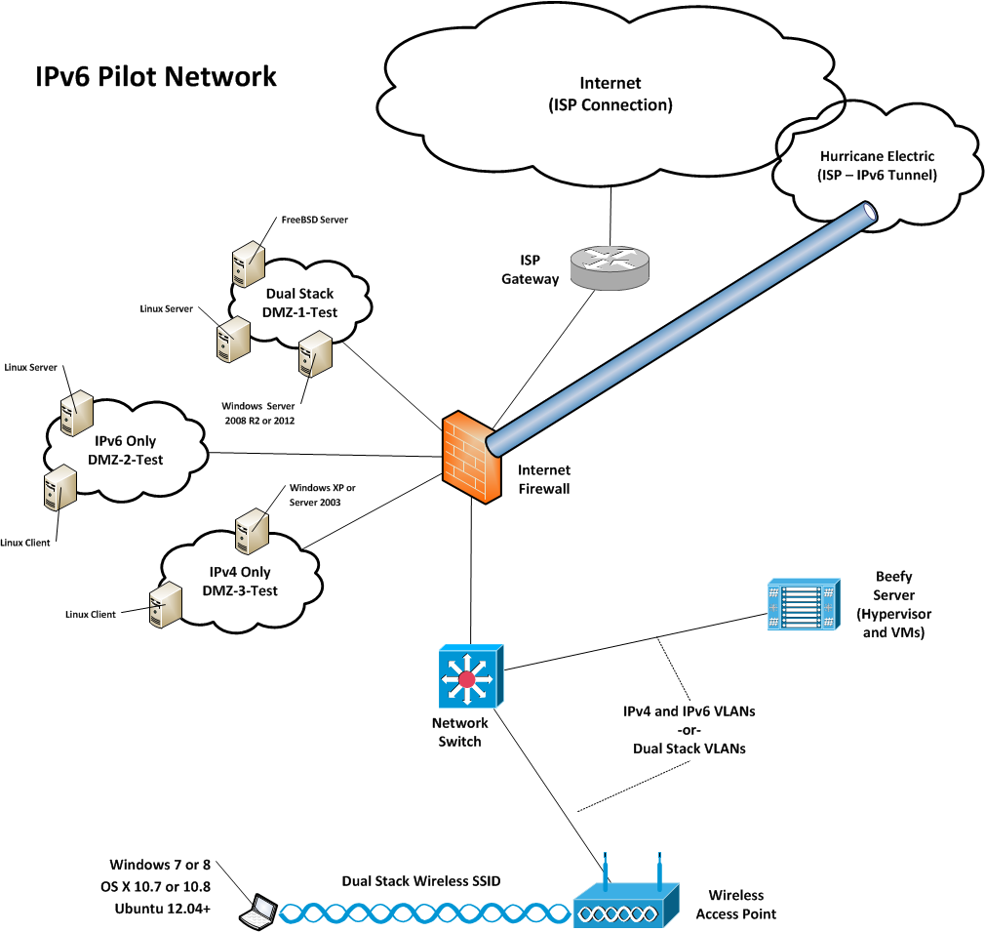
design your initial pilot topology
Notes:
Think of this as either a phase 1 pilot or as your lab; however, pitching it as a phase 1 pilot is probably easier from a business justification/funding perspective
This is a straight forward layout that gives you tremendous flexibility to pilot key areas for IPv6
The access switch and WLC can provide L2 IPv6 security
Pilot users can be joined via LAN or an opt-in Wireless Dual Stack SSID
Access to the dual stack VLAN/SSID can be controlled based on user attributes such as Active Directory Group Membership
For Internet Firewall – ASA, can even use 5505
For switches use 2960C/S, 3560C/E/X, 3750E/X – older switches don’t have required ASICs
For WLC use 2504/5508/vWLC
For Router use ISRG2 – many features require 15.2(4)M/S or later such as MP-OSPFv3 with VRF support

Slide 48
Initial Lab Roadmap
Obtain IPv6 /48 Prefix
Pilot Addressing Plan
Design and Build Out
Address Provisioning
DMZ Setup
Internal Network Setup
Notes:
Get your feet wet! Don’t start with the full roll out, start with a test network to get experience.

Slide 49

Obtain an IPv6 Network Address
Sign up for free IPv6 Internet access from Hurricane Electric (http://tunnelbroker.net)
With your account, request a /48 prefix
Q: Why start with Hurricane Electric?
A: It works great, service is available from anywhere on the Internet, and you get a /48 all for free.
Most important aspect of starting with HE:
You need practice creating an addressing plan and deploying IPv6. It will take you at least 3 times to get your addressing plan right so let’s get started…
Notes:
The initial test connection from your ISP may be a tunnel – that’s fine. The connection from HE will be a tunnel, again this is fine for getting started.
Don’t worry too much about the details at this point (e.g. PI versus PA or a global plan). Just get started.

Slide 50
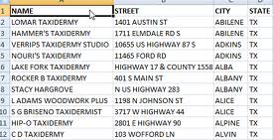
pilot Address Plan guidelines
Developing a great address plan takes practice
Site - /48
Loopback Network - /64
Loopback Interface - /128
Translation Services - /56
Point-to-Point* - /126
Everything else - /64
*Still good to set aside /64
Notes:
Start with an initial test plan with the comfort that you’ll revise it for production
Developing a great address plan takes practice
Obtained /48 is for one site
Reserve one /64 for loopbacks
Use a /128 for loopback addresses
Reserve a /56 (1/256th) for optional translations services*
You can use a /64, a /126, or a /127 for point-to-point network connections
/127s confuse some people and you should avoid using the 0 address in a subnet as its reserved for router anycast
/126s are better IMHO if you’re going to use a different prefix length for point-to-point connections
However – it is possible or likely that eventually you may need to add a firewall, a VIP, or something else that will require more than 2 addresses and then what? Use a /120 or a /112? That doesn’t make sense – just stick with a /64. The only reason /127s came into being is because Juniper has an ASIC problem that is susceptible to a ping-pong attack and thus they push /127s to mitigate there hardware issue. IOS doesn’t have this problem so unless you are positive it will always be true point-to-point or maybe you are doing some cool summarization then stick with /64s
Everything else should be a /64
Split up your /48 on nibble boundaries
Our example test site Network:
2001:db8:babe::/48
*Don’t mistake the reservation for a recommendation!

Slide 51
Example high level Pilot Address Plan
Create your addressing plan on nibble boundaries:
Split up your address allocation by Place In Network (e.g. 2001:db8:babe:X000::/52)
2001:db8:babe:0000::/52 – Management
2001:db8:babe:0000::/64 – Loopbacks
2001:db8:babe:1000::/52 – Labs
2001:db8:babe:2000::/52 – DMZs
2001:db8:babe:3000::/52 – Servers
2001:db8:babe:4000::/52 – User/Desktop
(…)
2001:db8:babe:F000::/52 – Special Purpose
2001:db8:babe:FF00::/56 – Reserved for translation services
Notes:
Each IPv6 network can hold over 18 quintillion devices so you won’t be using Excel to track individual nodes
However, a spreadsheet works great for tracking individual networks
4096 networks per PIN – Flexible (e.g. embed VLANs, additional location info, or other helpful pattern)

Slide 52
Pilot Address Plan thoughts
Prefixes
Basic subnet plan - spreadsheet
65k prefixes per /48 - not scalable!
Nodes
> 18 quintillion possible per subnet
Sizeable deployments - IPAM desirable
Reference:
IPv6 Subnetting Best Current Operational Practices
Notes:
Each IPv6 network can hold over 18 quintillion devices so you won’t be using Excel to track individual nodes
However, a spreadsheet works great for tracking individual networks
You can use a spreadsheet for a basic subnet plan (prefixes only)
At 65k prefixes per /48 this isn’t very scalable!
There are > 18 quintillion possible nodes per subnet – spreadsheets won’t cut it here
For any sizeable deployment you’ll want to look at DDI (IPAM) solutions

Slide 53
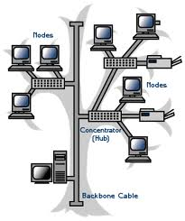
thoughts on initial topology
Network Types
Dual Stack
IPv4 Only
IPv6 Only
Areas to Look at:
Static/Dynamic Routing
Load Balancing
Proxying
Tunneling
NAT
Dual data/control/management planes
Notes:
Don’t get too caught up in the acronym soup for tunnel types and load balancing/NAT types – the important thing is to be aware that there are lots of options and you need to get familiar with the ones you might use and/or monitor for
Network Types
Dual Stack (Both IPv4 and IPv6)
IPv4 Only (Some things on your network are not going to do IPv6)
IPv6 Only (Eliminate the IPv4 crutch!)
Some things work differently in an IPv6 only network:
For example, you can’t use an IPv6 address to map a UNC path. Instead you must use an IPv6-Literal.Net address
Areas to Look at:
Dual stack = Two data/control planes
IPv4 and IPv6 are Ships in the Night
Static/Dynamic Routing
Load Balancing/ADC (SLB66, SLB64/46)
Proxying (Forward and Reverse)
Tunneling (ISATAP, 6in4, 6to4, 6rd, Teredo, AYIYA, TSP)
NAT (NAT66, NAT64/46, NPTv6, NAT-PT)
Note: NAT-PT is deprecated and shouldn’t be used. In IOS it only works if you disable CEF and thus provides poor performance – don’t use this.

Slide 54

A Word of Caution on NAT
NAT was invented for address conservation
Address conservation not needed for IPv6
Think carefully before using NAT
What applications will this degrade or break?
How much is operational complexity increasing?
How difficult does support become?
Notes:
Remember one of the key drivers of IPv6 – innovation. By deploying NAT you are stifling innovation and increasing costs – are you sure that’s what you want to do?
The only legitimate use of NAT that I see is NAT64 for IPv6 only networks to get to the IPv4 Internet. Other than that I would recommend avoiding it. I will also caution you that it’s complex. Unlike NAT44, with NAT64 there are endless possibilities and many of them are invalid. Because you are translating between different address families (remember that IPv6 is not IPv4 v2 but a different protocol) some combinations are invalid. You have to do both source and destination NAT as well as look at forward and reverse routing from both the IPv4 and IPv6 point of view. Again – think carefully before going down this path.
NAT or Network Address Translation was invented to help slow the exhaustion of IPv4 addresses
NAT is no longer needed with IPv6; however, it is an option
Think carefully before using NAT
What applications will this break/prevent?
How much am I increasing my operational complexity and costs?
All peer to peer traffic now requires a gateway/relay/tunnel including VoIP, video conferencing, and collaboration
Degrades experience – Skype, Facetime, WebEx, and Sharepoint Workspace function better without NAT
Troubleshooting can become daunting
More thoughts in the Appendix

Slide 55
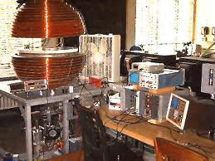
Build Out initial lab
Infrastructure setup
Hypervisor setup
Physical and Virtual Nodes with representative Operating Systems
Key Applications
Notes:
Infrastructure setup
Router(s), Switch(es), Firewall(s), Wireless
Hypervisor setup (ESXi/Hyper-V/Xen/KVM)
Physical and Virtual Nodes with representative Operating Systems
Windows XP/Vista/7/8; OS X 10.6, 10.7, 10.8
Linux Client (e.g. Ubuntu Linux 12.04+)
Windows Server 2003 (R2)/2008 (R2)/2012
Linux Servers (e.g. CentOS, RHEL, SLES)
BSD Servers (e.g. FreeBSD, OpenBSD)
Key Applications
Web, E-mail, Database, CMS (Anything Internet Facing is crucial)

Slide 56
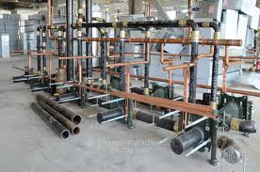
IPv6 Support Infrastructure
DNS
Transport
Accessibility
Dynamic DNS
DHCPv6
Stateless
Stateful
WINS/NetBIOS
Viability
Recommendations
Notes:
SLAAC or Stateless Address Auto Configuration allows IPv6 nodes to automatically configure themselves with an IPv6 address when a router on their link or network advertises the appropriate network to use
As you start entering IPv6 forward and reverse DNS records you will find it quite tedious.
You may want to look at an IPAM solution. There are also many third party IPAM solutions including Infoblox.
(D)DNS
Both IPv4 A records and IPv6 AAAA records can be transported over either IPv4 or IPv6
Pilot should include DNS services accessible over IPv6 transport
Dynamic DNS (nodes register address with DNS server) highly recommended
DHCPv6
Configure and test both stateless and stateful modes
Dynamic integration with DNS server highly recommended
WINS/NetBIOS
Just to state the obvious – WINS and NetBIOS are IPv4 only protocols
Eliminate and validate there are no remaining dependencies

Slide 57
IPv6 Address provisioning thoughts
Address Options and Applicable Systems:
Pure Static (Must disable SLAAC)
Static with Options
SLAAC, no DHCPv6
Basic
RDNSS
Dynamic VLAN Assignment
SLAAC with (Stateless) DHCPv6
DHCPv6 (Stateful DHCPv6)
Still requires SLAAC for default gateway
Notes:
SLAAC or Stateless Address Auto Configuration allows IPv6 nodes to automatically configure themselves with an IPv6 address when a router on their link or network advertises the appropriate network to use
As you start entering IPv6 forward and reverse DNS records you will find it quite tedious.
You may want to look at an IPAM solution. For those with perpetual Microsoft licensing, Microsoft has what looks to be a pretty slick IPAM solution built-in to Server 2012. There are also many third party IPAM solutions including Infoblox.
Static (no dynamic options)
Infrastructure devices (routers, firewalls, etc.)
Key infrastructure servers (DNS, DHCPv6, Active Directory)
Static (use SLAAC for default gateway and/or DNS)
Option 1 for Servers
SLAAC, no DHCPv6
Some systems (Android) can only do SLAAC
Some systems support RDNSS but not stateless DHCPv6 (Ubuntu Linux)
Ideally use a something like Cisco’s ISE that can assign devices that don’t do DHCPv6 to a SLAAC VLAN
SLAAC with (Stateless) DHCPv6
Possibility for guest networks
DHCPv6 (Stateful DHCPv6)
General recommendation for the enterprise
Provides much more control over addressing
Provides accountability and stable addressing – especially important for Apple iOS devices which churn through too many addresses with SLAAC
Option 2 with reservations for Servers*
*Really?!? Servers without static addressing? Yes – some organizations have successfully used this approach. Don’t let IPv4 constrain your thinking!

Slide 58

Build Your IPv6 DMZ
In order of preference:
Option 1 – Dual Stack
Option 2 – Load balanced (SLB64)
Option 3 – Dual Stack Reverse Proxy
Option 4 (Discouraged) – Use NAT64
Notes:
Again, dual stack means both IPv4 and IPv6 simultaneously
Where dual stack isn’t possible you can look at load balancing; for things like web traffic you can have the load balancer insert an X Forwarded For header with the real IPv6 client address; careful with the XFF header though – you will need to make sure your systems/applications can deal with it
NAT64 may seem appealing but it has many subtle gotchas and drawbacks – remember that IPv4 and IPv6 are different protocols with different inner workings; when you do NAT and essentially try to pretend that they are similar protocols you can have hard to troubleshoot problems such as Path MTU
In order of preference:
Option 1 – Dual Stack for border router(s), firewall(s), and server(s)
Option 2 – Use load balancer(s) (IPv6 towards Internet, IPv4 towards servers)
Option 3 – Use dual stack reverse proxy (IPv6 towards Internet, IPv4 towards servers*)
Option 4 (Discouraged) – Use NAT64 (Operationally complex to troubleshoot and maintain)
*Some questions about solution security

Slide 59

Build Your IPv6 internal Network
Connect Internal IPv6 Network to IPv6 Internet
Option 1 (Preferred) – Dual Stack
Option 2 – Forward Proxy
Option 3 – (Legacy) Tunneling
Option 4 – Stateful NAT64 (IPv6 Only)
Notes:
Create an IPv6 path from your test IPv6 Network out to your IPv6 Internet connection
Option 1 (Preferred) – Dual Stack all the way
Option 2 – Use tunneling (ISATAP for Windows/Linux, 6in4 for OS X)
Option 3 – Use a (forward) Proxy (limited application/protocol support)
Option 4 – Use Stateful NAT64 for IPv6 only networks, this is the ideal use case
Don’t forget about your supporting infrastructure!

Slide 60
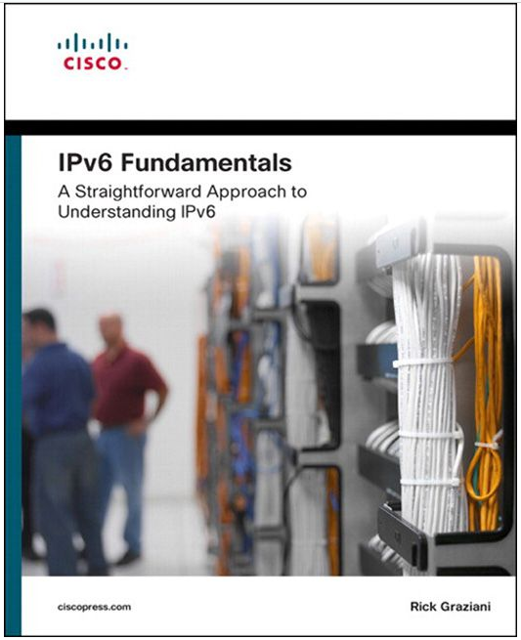
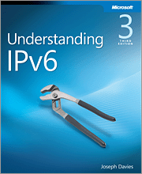

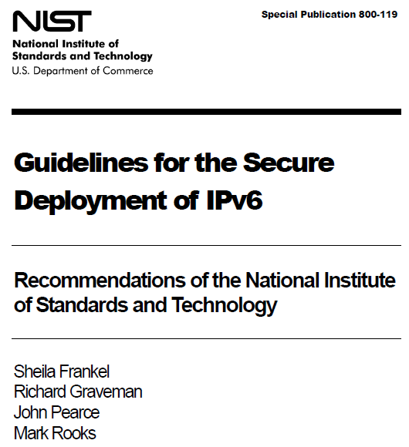
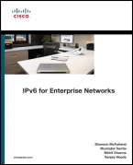
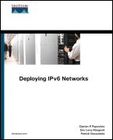


Recommended Reading

Slide 61




Questions
?
My IPv6 Blogs:
Packet Pushers
@netsec14

Slide 62
Appendix
Notes:
Should be here around 35 minutes

Slide 63
Ipv6 Connectivity Options
In order of preference:
Native dual stack (e.g. Comcast XFinity)
You have a direct public IPv4 address:
6rd – Must be supported by your ISP
Tunnelbroker (6in4 tunnel) – Hurricane Electric
Unmanaged 6to4 tunnel – Works better if your ISP supports, but will work without too
Behind a NAT gateway/CGN/LSN or can’t terminate ISP connection:
AYIYA to Tunnelbroker (SiXXS)
TSP with Gogonet (Freenet6)
VPN or Tunnel Connection to someplace with IPv6 support
Use public Teredo/Miredo servers (but performance isn’t great)

Slide 64
IPv6 prefix policies
When multiple transport protocols are used (IPv4 and IPv6), a method must exist to choose which one is used including:
Use IPv4 or IPv6?
Where multiple addresses exist:
Which destination address should be chosen?
Which source address should be chosen?
RFC 3484 - Default Address Selection handles this
Prefix policies (RFC 3484 implementation) may be viewed and changed:
Windows: netsh interface ipv6 show prefixpolicies
Linux: ip addrlabel show

Slide 65
Windows IPv6 Basics
New Windows Commands - netsh interface ipv6:
show addresses | Detailed information on IPv6 interface addresses
show destinationcache | Displays the contents of the destination cache, sorted by interface; the destination cache stores the next-hop addresses for destination addresses
show global | Shows global configuration parameters such as interface address randomization
show interfaces | Detailed interface list including index numbers/zone identifiers, also try level=verbose
show neighbors | Displays contents of the neighbor cache, sorted by interface; the neighbor cache stores the link-layer addresses of recently resolved next-hop addresses
show prefixpolicies | Shows prefix policy table (IPv6 versus IPv4 preference order)
show privacy | Shows interface address privacy configuration parameters
Note: netsh commands can be abbreviated:
netsh interface ipv6 show interface
Abbreviate as:
netsh int ipv6 sh int

